Slide 1
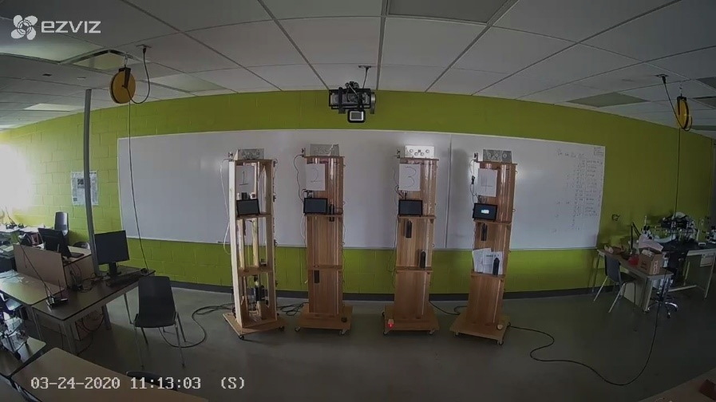

Project VI
The Elevator Project

Slide 2
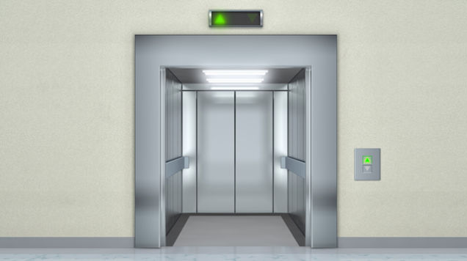
The Elevator Project
Course website/portal
Course Outline
Project Charter
Course Delivery Schedule
Instructors:
Michael A. Galle
Room A3223, Cambridge Campus
Tel. Ext. 2283
mgalle@conestogac.on.ca
Ali Tehrani
Room A3223, Cambridge Campus
Tel. Ext. 3275
atehrani@conestogac.on.ca

Slide 3
Semester Info

Slide 4
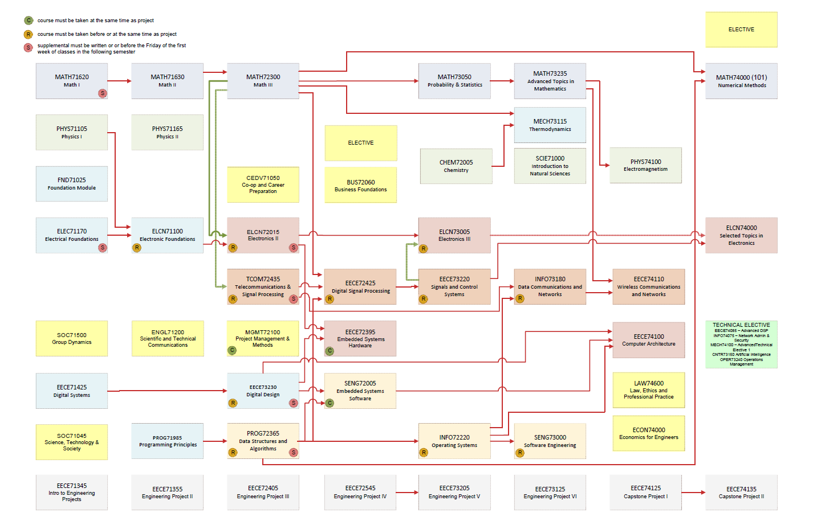
Current Semester

Slide 5
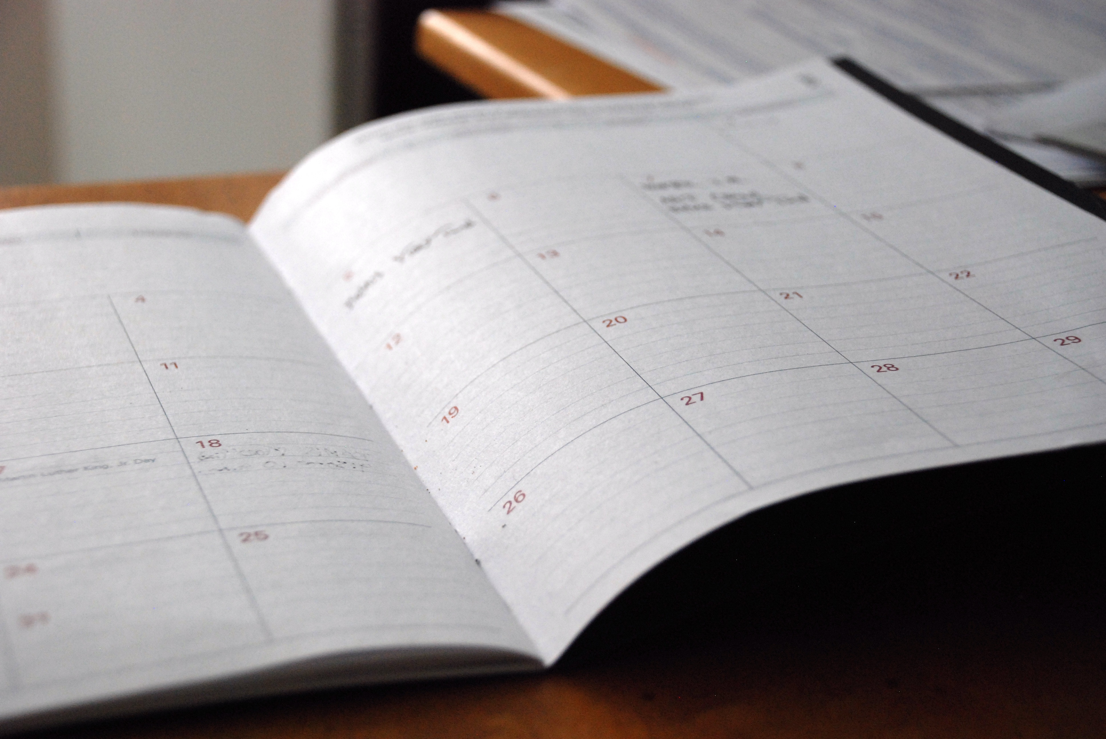
Your Weekly Schedule

Slide 6
Semester Week-By-Week

Slide 7
Brief Project Introduction

Slide 8

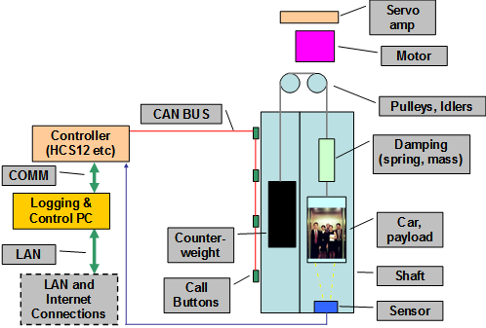
Elevator Components
Motor control
Raspberry Pi
Wifi
Distance information

Slide 9

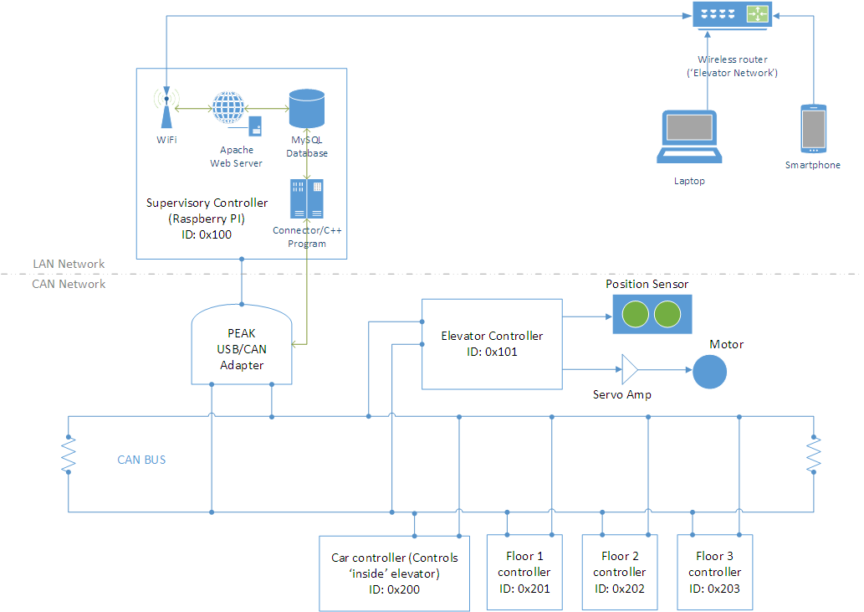
CAN / LAN Network Diagram

Slide 10

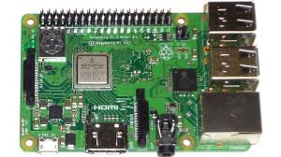
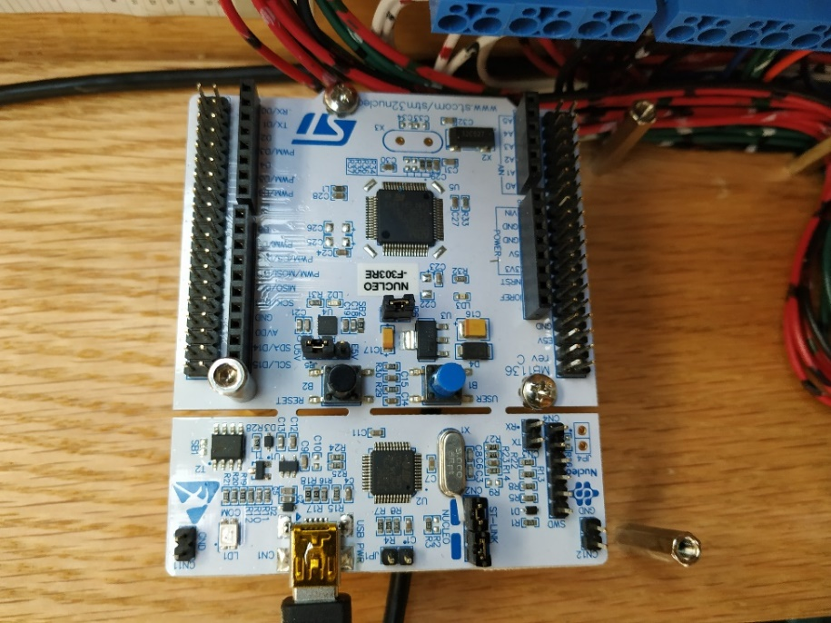
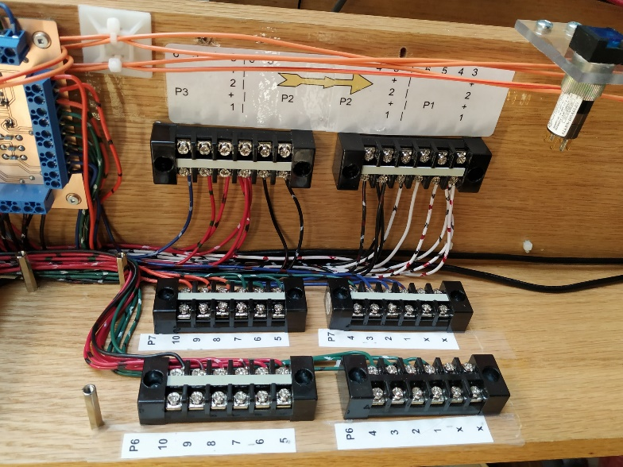
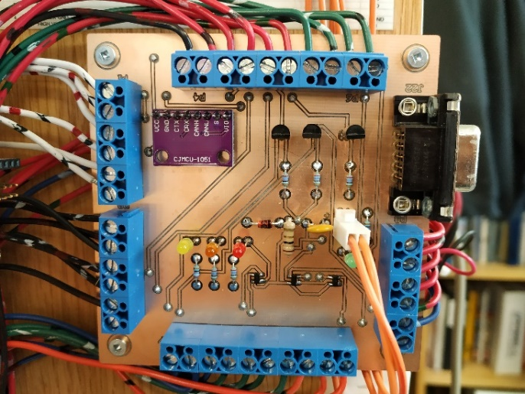
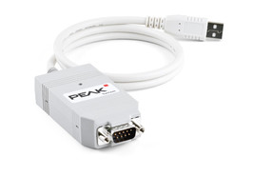
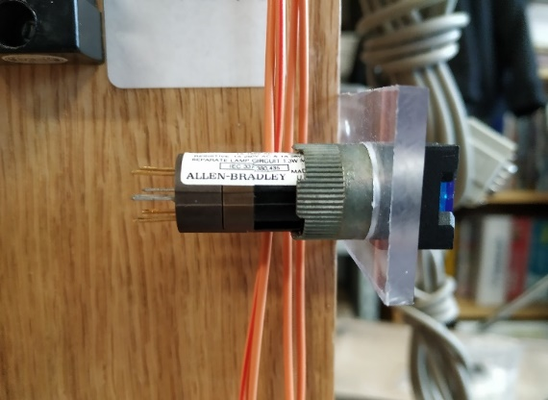
Key Components
Raspberry Pi
USB/CAN
1
4
Header Panel
STM32 Nucleo Board
CAN Transceiver, Floor Indicator and debounce circuits
Floor Req. pushbutton
3. COVID-19
2

Slide 11
Connection to Theory in this semester

Slide 12


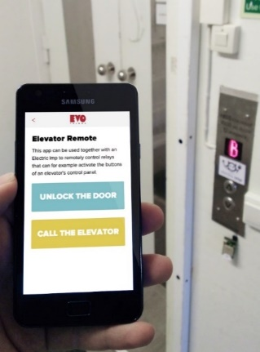

Software Engineering
In this project we will build a ‘connected’ elevator with database and control features that will be accessible via a web-page
What should we learn to do this?
Notes:
https://evomedia.evothings.com/2013/11/Electric_Imp_elevator_remote_app.jpg

Slide 13
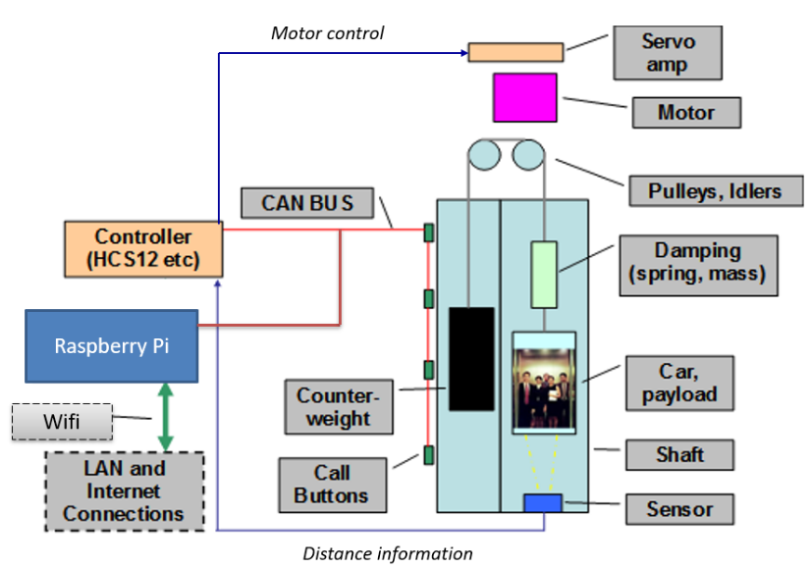
Software Engineering
Back-End Development
Server (PHP/C++, possibly Python)
Databases (MySQL)
Driver control of PCAN USB/CAN
adapter (C/C++)
Front-End development
Website (HTML, CSS, JavaScript)
Notes:
https://www.peak-system.com

Slide 14


Data Communications
CAN and LAN networking and communications protocols
CAN/GPIO programming & communications of the floor/elevator nodes using the Hardware Abstraction Layer (HAL)
How CAN & Ethernet transceivers encode the signals on a bus
Notes:
https://www.peak-system.com

Slide 15

Datacom: Programming the STM32 for CAN/GPIO
STM32CubeMx screenshot of STM32 clock tree – Programming via HAL

Slide 16
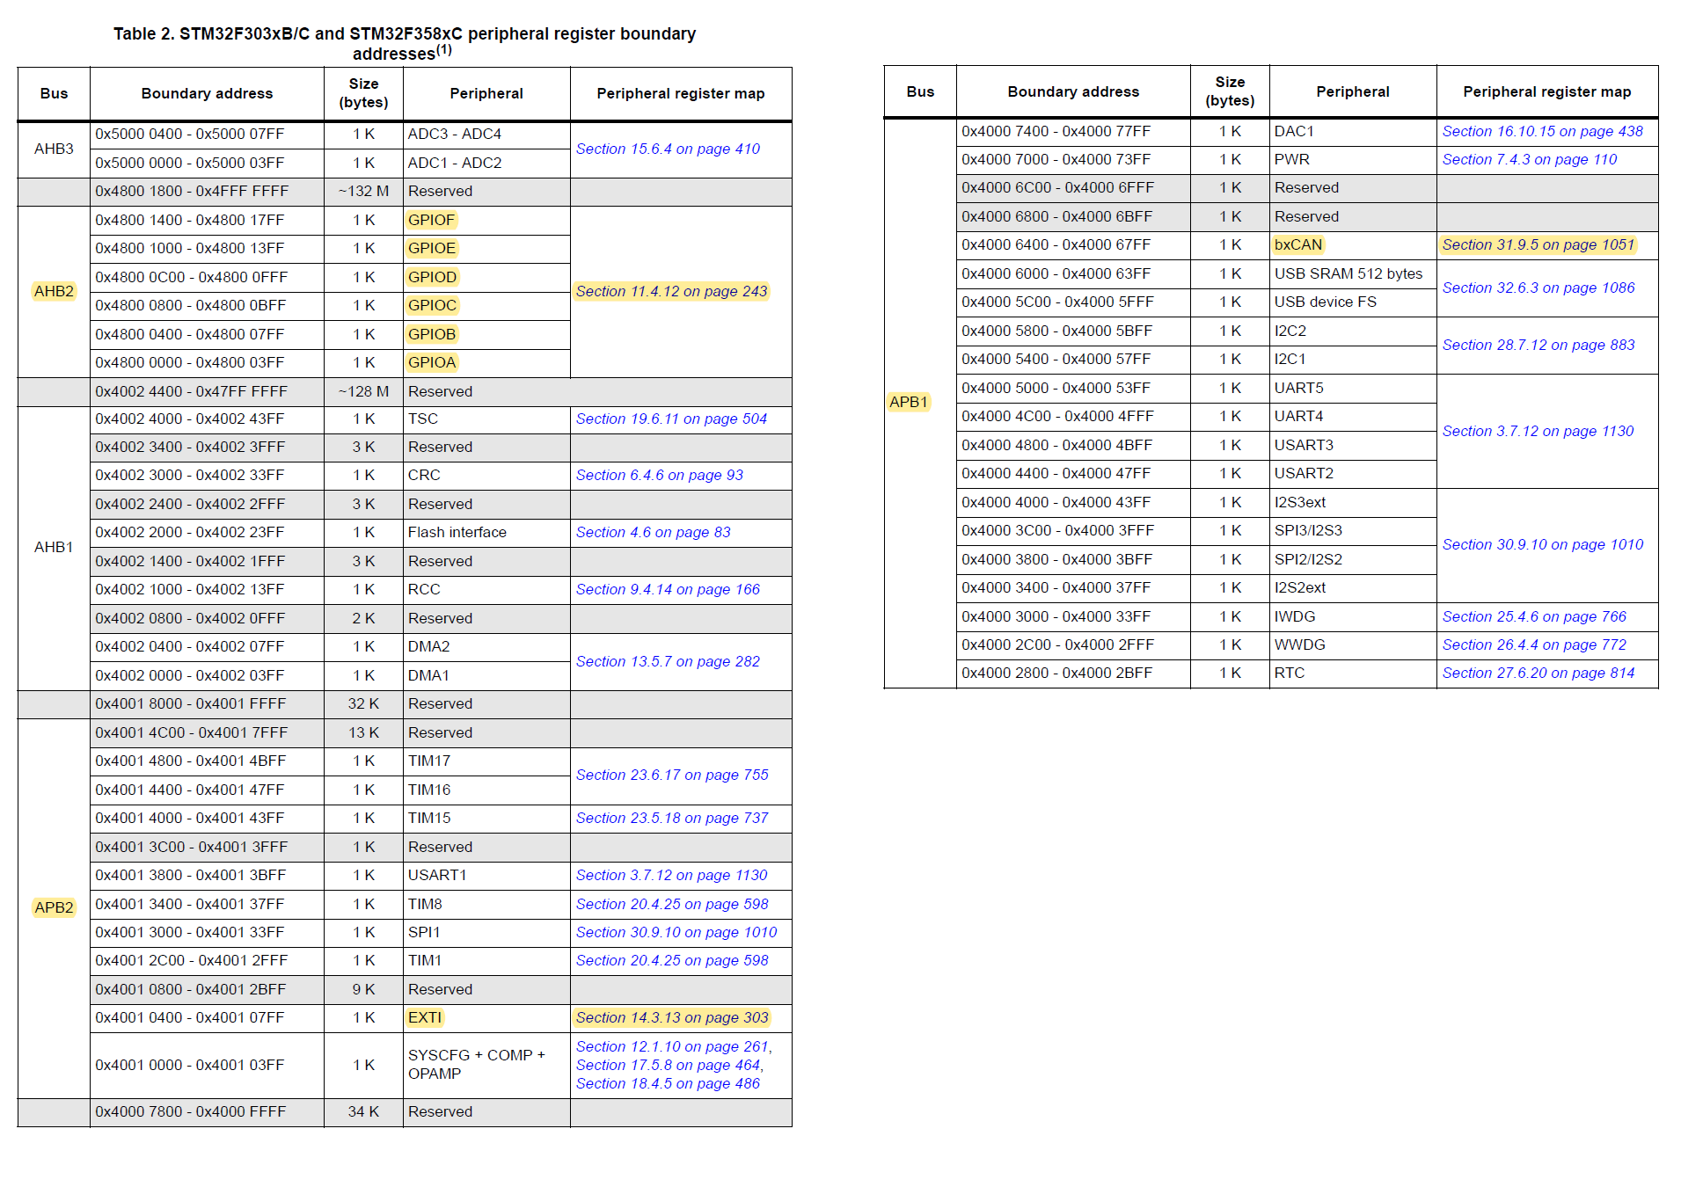
Datacom: Programming the STM32 for CAN/GPIO
Source: STM32 Manual

Slide 17
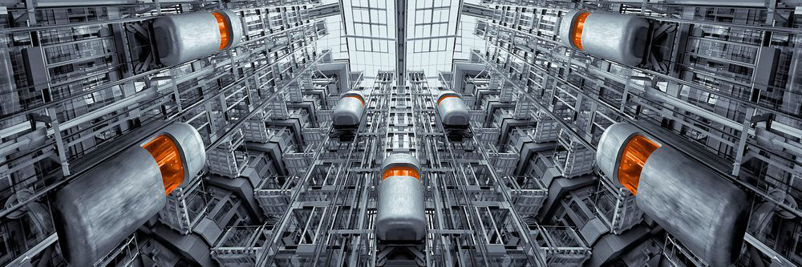
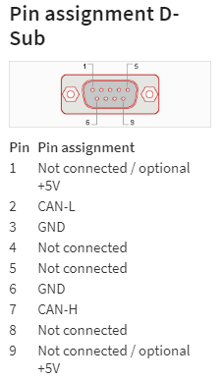
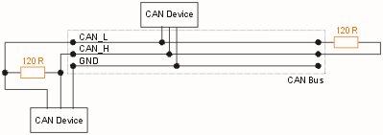
Datacom: CAN Network Components
CAN controller is usually part of the microcontroller
CAN transceiver is usually a separate IC
Source: STM32 Manual
Notes:
http://www.interfacebus.com/Can_Bus_Connector_Pinout.html
https://www.peak-system.com/PCAN-USB.199.0.html?L=1

Slide 18

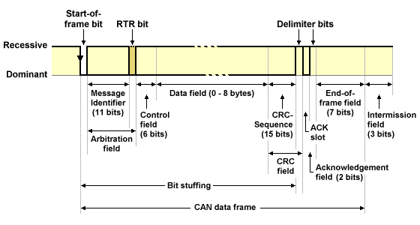
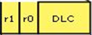
Datacom: CAN Frames / Capabilities
Standard Mode Frame Format

Slide 19
Project Details

Slide 20

Project Phases
Project 6
Phase 1 (2 Wks): CAN network
Phase 2 (7 Wks): LAN network, remote control, database and programming
Phase 3 (3 Weeks): System integration
Phase 1
Phase 2
Phase 3
COVID-19

Slide 21
Phase 1
Implement a CAN messaging protocol that is common amongst all groups
Implement a node configuration that is common among all groups
Fully functioning CAN network involving a variety of controlling and controlled devices and more than two CAN-nodes
Test plan and results
Modification due to COVID-19
- Phase reduced to 2 weeks
- Functionality to be simulated and group members will each program the STM-32 nucleoboard as per separate instructions

Slide 22
Phase 2
Build a user interface for control
Build a remotely accessible (read/write) data repository
Build an internet based remote access system to monitor and control an industrial system

Slide 23
Phase 3
Connect the CAN network to the LAN network (internet)
Build a fully functioning CAN diagnostic and reporting system
Design and implement at least one unique feature or capability
Prepare Project Ideas for Capstone
Final project report / presentation
COVID-19

Slide 24

Marks Distribution
Phase 1: 25%
Phase 2: 25%
Phase 3: 25%
Overall performance: 25% (individual mark)
There will be weekly debrief sessions as well as End-of-phase debriefs. All will use defined rubrics already in eConestoga

Slide 25
Policies & Procedures
Marks for each phase will be assigned at the end of the phase.
No project marks will carryover from one phase to another.

Slide 26
Project Management
Project plan that assigns tasks for each group member by week. (Due next Monday) – Later converted to online Gantt chart
Weekly status reports - See Status Report Template
Engineering logbook – Each team member shall keep an online logbook and shall update and present it weekly
Meeting minutes should be recorded in your online Logbooks

Slide 27
Technical Documents
Design documents - design outcomes, justifications, calculations, application-of-theory, comparisons, as appropriate.
Test plans - expected results including allowable deviations
Final report and presentation - includes research and investigation work, design work, test plans and results. Must be a comprehensive analysis of your work including product features, capabilities and limitations.
Each document is evaluated with a rubric, which is available in eConestoga
You may wish to upload some of these to your project website

Slide 28

End-of-Phase Debriefing
The End-of-Phase Evaluation includes both a Group and an Individual assessment

Slide 29
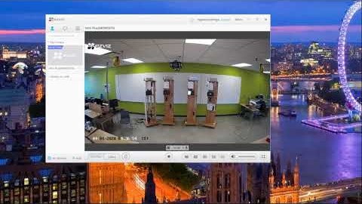
Remote Connection to Elevators (watch later)
https://youtu.be/NkdtqAjuLWk
There is also a document in eConestoga with these details

Slide 30
Complete group sign up sheet: Google doc
Project Plan: (Sample Gantt Chart in eCon)
Read Project Charter (eCon)
To Do

